Slide 1
ICCHP-AAATE 2022
July 11-15, 2022 at Lecco, Italy
An Efficient Method to
Produce Accessible Contents
for Online STEM Education
Toshihiko KOMADA
Katsuhito YAMAGUCHI
(Nihon University, Japan)
Masakazu SUZUKI
(Kyushu University, Japan)

Slide 2
1. Introduction
Present situation of STEM educational materials for online lectures
  For sighted students
    Created with PowerPoint
    Provided as lecture videos in MP4 and/or PDF
    Displayed on a computer screen in online real-time lectures
  For print-disabled students
    They should access the entire educational content for themselves at home
      In case of the lecture were face-to-face, a teacher could explain directly any part of the PPT or PPT-originated educational materials as necessary even if they were not necessarily accessible.

Slide 3
Accessibility of PowerPoint contents for Print-disabled students
Non-Technical Contents
  We actually can produce accessible PPT contents in a certain level
STEM contents
  Print-disabled students hardly access important elements such as math formulas, diagrams and tables included in STEM educational materials

Slide 4
Math Accessibility of PowerPoint
PowerPoint
  No good tool to make PowerPoint or PowerPoint-originated STEM contents be accessible
  Embedding alternative text
  Add audio (aloud reading) information
    Manual work (require a lot of extra time)

Slide 5
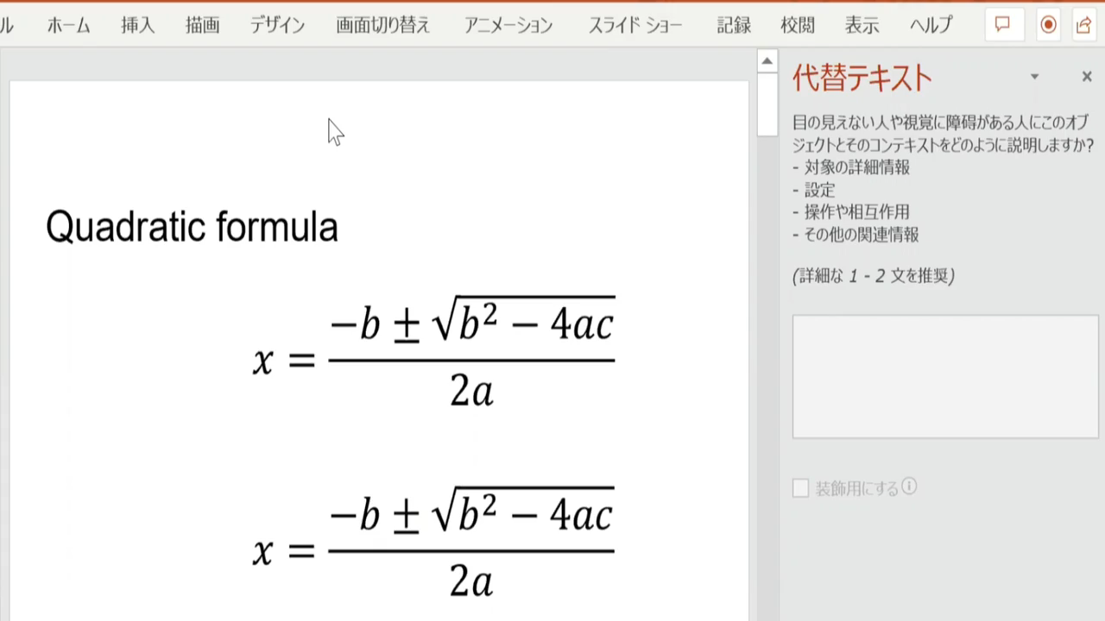
Demo Inaccessible a Math Formula
Read out with JAWS the two cases, math formula in Office/image

Slide 6
Infty Software
Assistive tools for print-disabled people to access STEM contents
ChattyInfty
  Edit, Reading out a content with a TTS voice / Export to EPUB 3, HTML5, MS-Word, …
InftyReader
  OCR for STEM Doc. / Export to ChattyInfty format, EPUB3, MS-Word, …

Slide 7
Purpose of This Work
A new efficient method to make PPT or PPT-originated STEM educational content be accessible by making use of Infty software.
  Add-on for PowerPoint
  Embed easily an alt text and aloud reading with a TTS voice to any technical part
  An accessible MP4 video for STEM education also can be produced efficiently.

Slide 8
2. Method
The Add-on for Powerpoint was Developed with VBA
PC System Requirements
  OS: Microsoft Windows 8.1 or later
  Software:
    PowerPoint
    ChattyInfty
    InftyReader

Slide 9
Three ways to embed the alt text or the MP3 aloud reading audio file for each math part in PowerPoint slides.
  Converting a math part in an existing PowerPoint slide into the alt text or the MP3 audio file and embedding.
  Converting a math part in PDF into the alt text or the MP3 audio file.
  Newly creating a math formula together with its alt text or MP3 audio file.

Slide 10
DEMO: Method 1
Converting a math part in an existing PowerPoint slide into the alt text and the MP3 audio file and embedding.

Slide 11
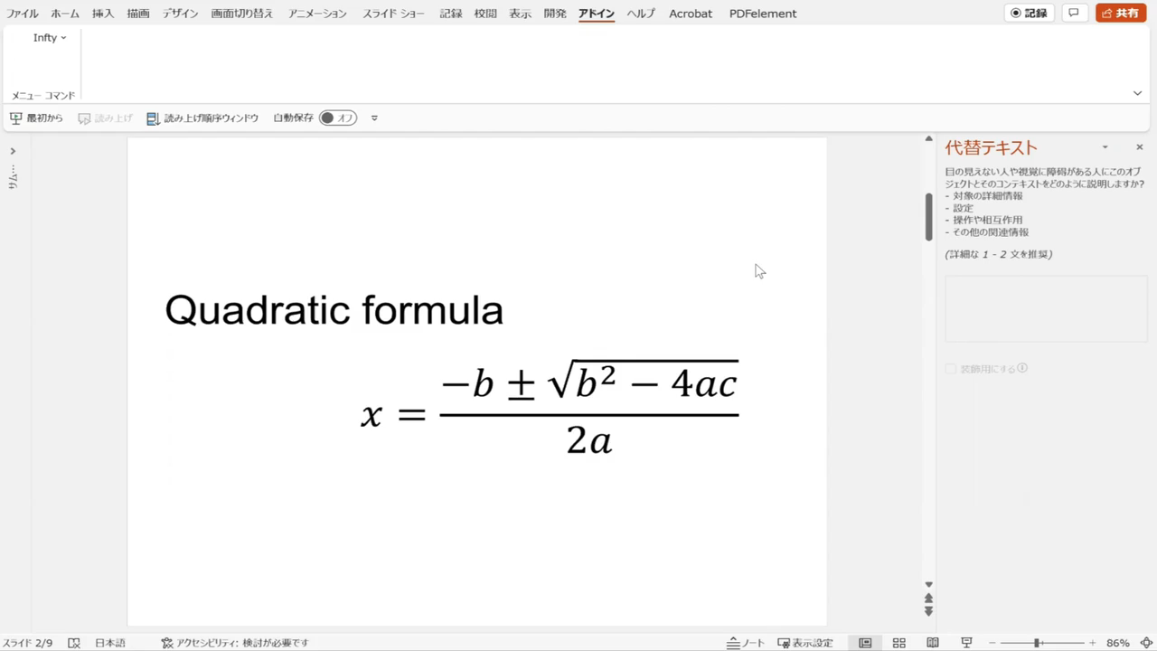
Demo
How to make accessible math contents
for math formula in Office

Slide 12
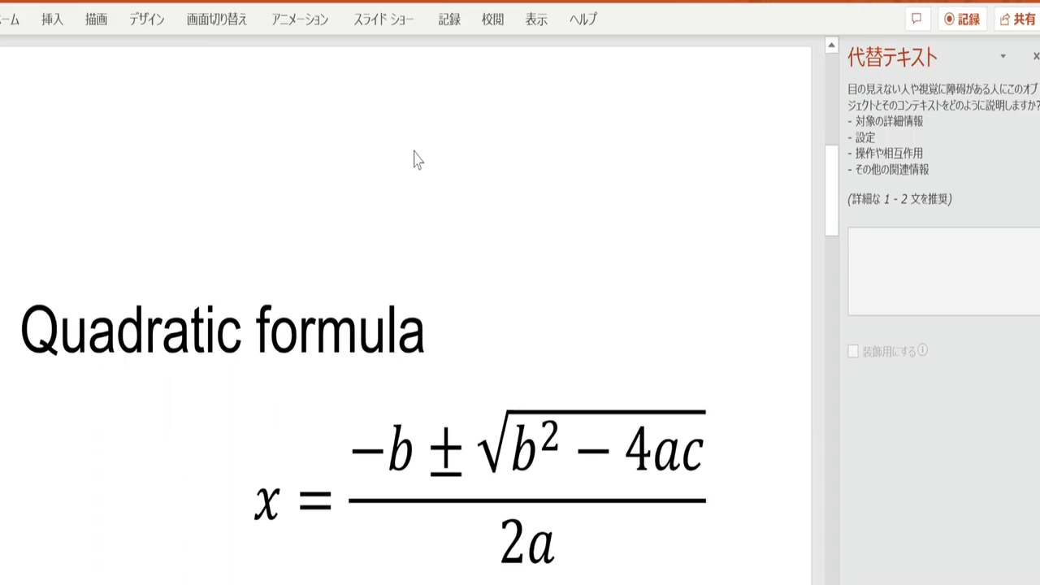
Demo
Read out with JAWS

Slide 13
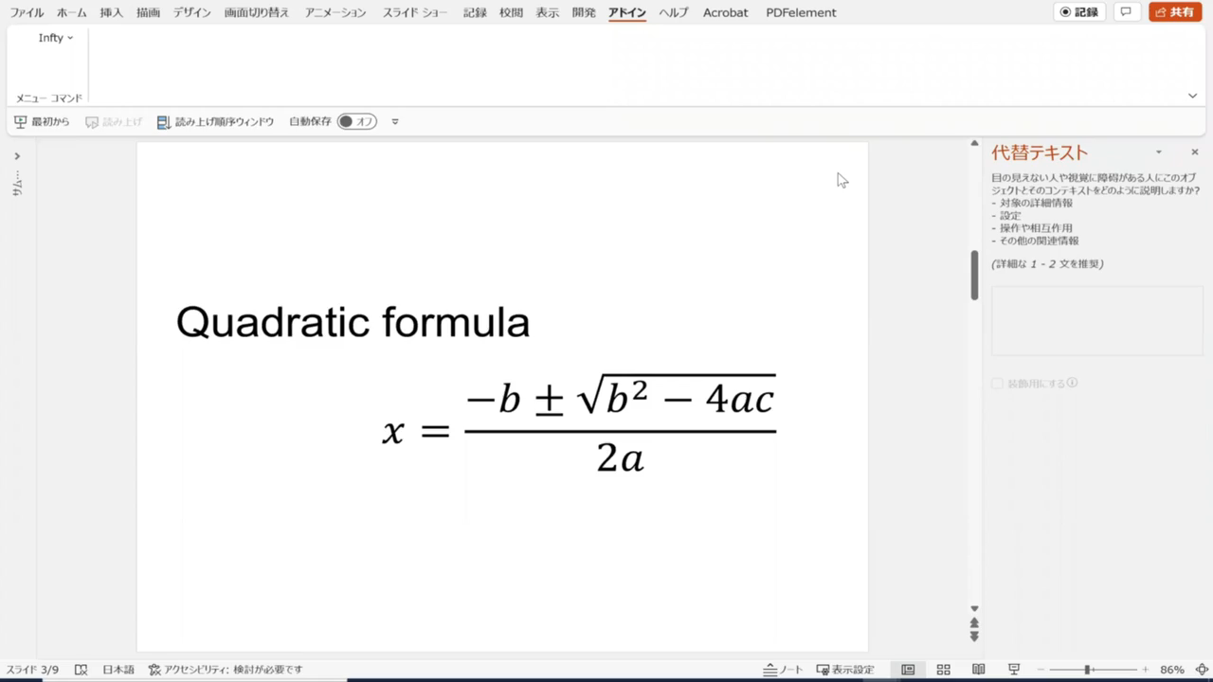
Demo
How to make accessible math contents
for math formula in image

Slide 14
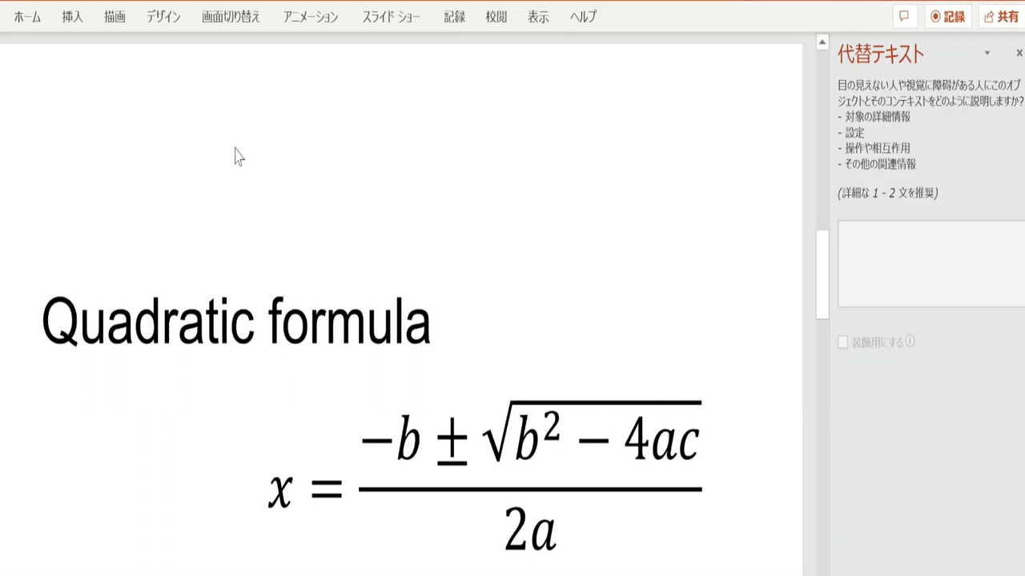
Demo
Read out with JAWS

Slide 15
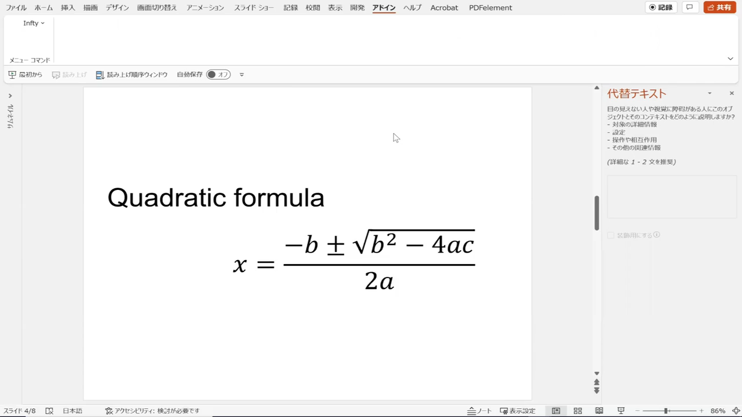
Demo
Can access more smoothly a math formula in Office
converting Office object into SVG image

Slide 16
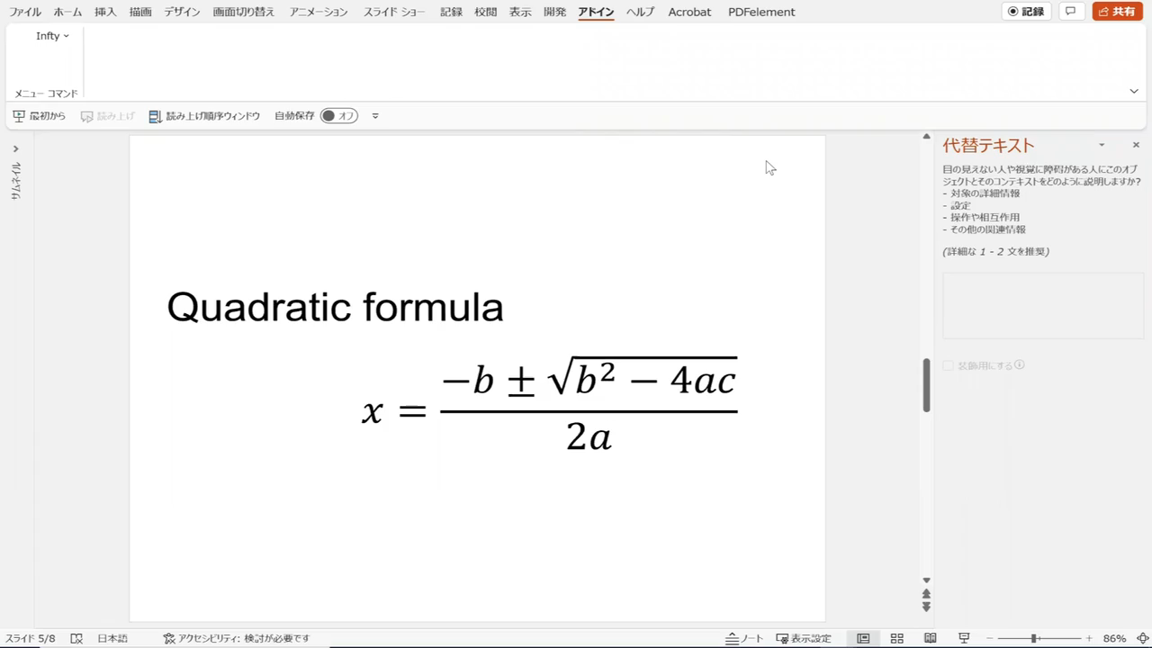
Demo
Can access more smoothly a math formula in Office
importing audio object of aloud reading

Slide 17
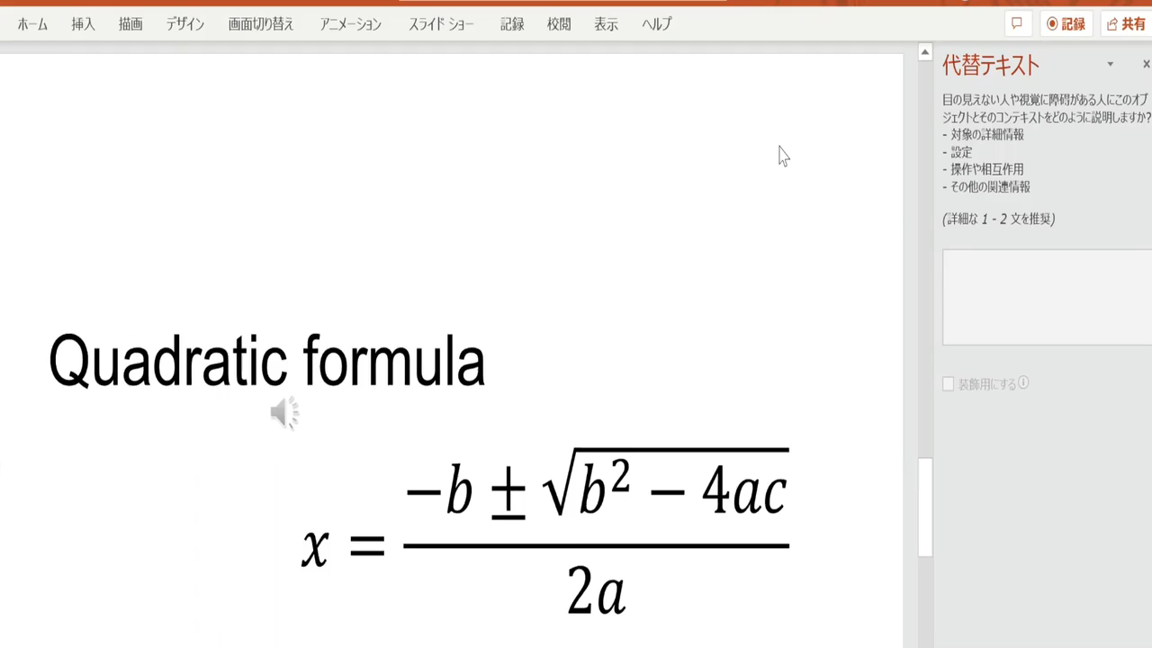
Demo
importing audio object of aloud reading

Slide 18
Conclusion
Here, we show a new efficient method to make PPT or PPT-originated STEM educational content be accessible by making use of Infty software. Using its functions, our new add-on for PowerPoint allows you to embed easily an alt text or aloud reading with a TTS voice to any technical part such as math expressions included in PPT slides. An accessible MP4 video for STEM education also can be produced efficiently.

Slide 19
Future Tasks
Realizing more-automatic processing in the workflow
Making the add-on multilingual
Seamless transformation between PowerPoint and ChattyInfty formats
    PPT content (via ChattyInfty) into various other accessible formats
      multimedia DAISY
      accessible EPUB3
      audio-embedded HTML5 (ChattyBook)

Slide 20
Evaluation for the PPT add-on
    → Release the official version in the near future
Science Accessibility Net
https://sciaccess.net/en/

